Slide 1
Computer Organization & Architecture
Chapter 2 – Instructions Set Architecture
Junying Chen 陈俊颖

Slide 2
Content of this lecture
2.3 Instruction and Instruction Sequencing
E.4 Instruction Formats
2.4 Addressing Modes
2.6 Stacks
2.7 Subroutines
2.8 Additional Instructions
2.10 CISC Instruction Sets
2.11 RISC and CISC Styles

Slide 3
2.3 Instruction and Instruction Sequencing
  Register Transfer Notation
  Assembly-Language Notation
  RISC and CISC Instruction Sets
  Introduction to RISC Instruction Sets
  Instruction Execution and Straight-Line Sequencing
  Branching

Slide 4
Instruction and Instruction Sequencing (1)
Four Types of Instructions
  Data transfers between the memory and the processor registers
  Arithmetic and logic operations on data
  Program sequencing and control
  I/O transfers
Register Transfer Notation
  Memory Location: LOC, PLACE, A, VAR2
  Processor Register: R0, R5
  I/O Subsystem Register: DATAIN, OUTSTATUS
  The contents of any location are denoted by placing square brackets around its name: R2 ← [LOC]
  Register Transfer Notation: R4 ← [R2] + [R3]
    The righthand side of an RTN expression always denotes a value, and the left-hand side is the name of a location where the value is to be placed, overwriting the old contents of that location.

Slide 5
Instruction and Instruction Sequencing (2)
Assembly-Language Notation
  Example1: Load R2, LOC
    The transfer from memory location LOC to processor register R2
  Example2: Add R4, R2,R3
    Registers R2 and R3 hold the source operands, while R4 is the destination.
Mnemonics
  Assembly languages for different processors often use different mnemonics for a given operation.
  E.g. Load LD
  Store STR or ST
Notes:
Mnemonics：记忆术、助记术

Slide 6
Instruction and Instruction Sequencing (3)
RISC and CISC Instruction Sets
  Design a computer starting by defining ISA.
  What is instruction set architecture (ISA)?
  ISA
    Defines registers
    Defines data transfer modes (instructions) between registers, memory and I/O
    There should be sufficient instructions to efficiently translate any program for machine processing
  Next, define instruction set format – binary representation used by the hardware
    Variable-length vs. fixed-length instructions

Slide 7
Instruction and Instruction Sequencing (4)
RISC and CISC Instruction Sets (ctd.)
  Types of ISA
    Reduced instruction set computer (RISC)
      Small set of instructions (typically 32)
      Simple instructions, each executes in one clock cycle – REALLY? Well, almost.
      Effective use of pipelining
      Example: ARM
    Complex instruction set computer (CISC)
      Many instructions (several hundreds)
      An instruction takes many cycles to execute
      Example: Intel Pentium

Slide 8
Instruction and Instruction Sequencing (5)
Introduction to RISC Instruction Sets
  Two key characteristics of RISC instruction sets
    Each instruction fits in a single word.
    A load/store architecture is used, in which
      Memory operands are accessed only using Load and Store instructions.
      All operands involved in an arithmetic or logic operation must either be in processor registers, or one of the operands may be given explicitly within the instruction word.

Slide 9
Instruction and Instruction Sequencing (6)
Introduction to RISC Instruction Sets (ctd.)
  Load Instruction Format
    Load destination, source
    Load processor_register, memory_location
  Store Instruction Format
    Store source, destination
  Add Instruction Format
    Add destination, source1, source2

Slide 10
Instruction and Instruction Sequencing (7)
Introduction to RISC Instruction Sets (ctd.)
  Example: C = A + B
  C ← [A] + [B]
    Load R2, A
    Load R3, B
    Add R4, R2, R3
    Store R4, C

Slide 11
Instruction and Instruction Sequencing (8)
Instruction Execution and Straight-Line Sequencing
  Example:
  C = A + B
  C ← [A] + [B]
  Assume that
    The word length is 32 bits
    The memory is byte-addressable
    A desired memory address can be directly specified in Load and Store instructions.
Notes:
Straight-line sequencing: 线性序列
讲到这里—2018.10.25

Slide 12
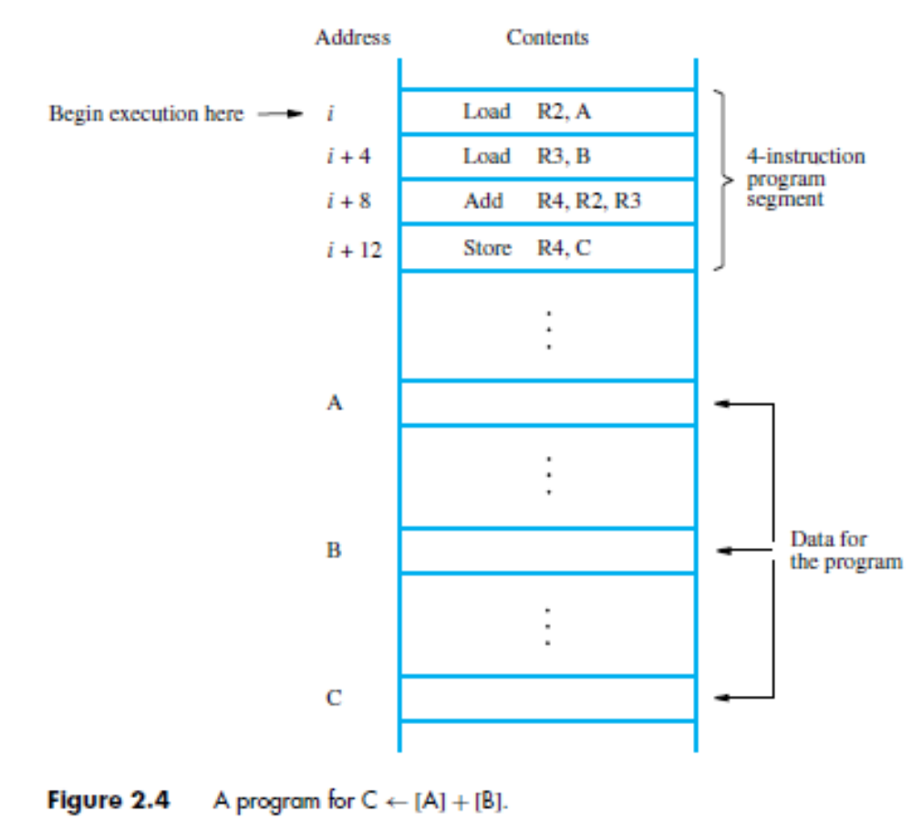
Instruction and Instruction Sequencing (9)
Instruction Execution and Straight-Line Sequencing (ctd.)
  Straight-line
  Sequencing
  [PC]= i
  [PC]= i +4
  …
  Instruction Fetch
  Instruction Execute

Slide 13
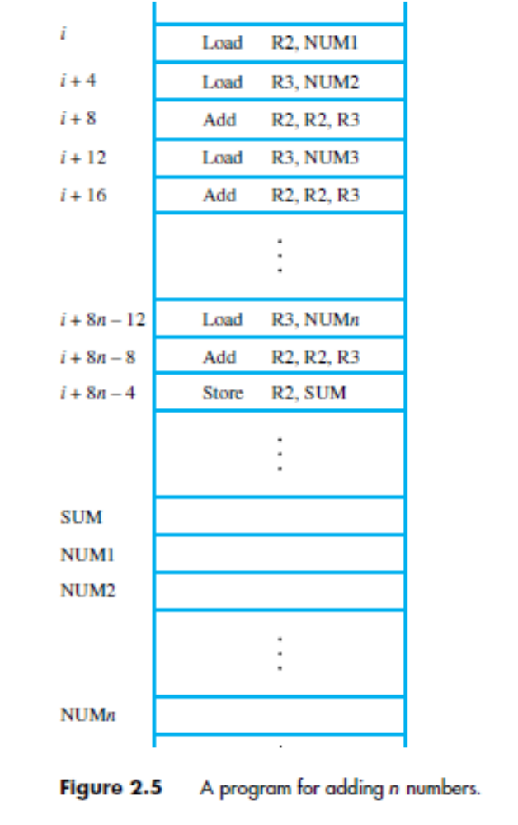
Instruction and Instruction Sequencing (10)
Branching
  Adding a list of n numbers
    Separate Load and Add
    Instructions

Slide 14
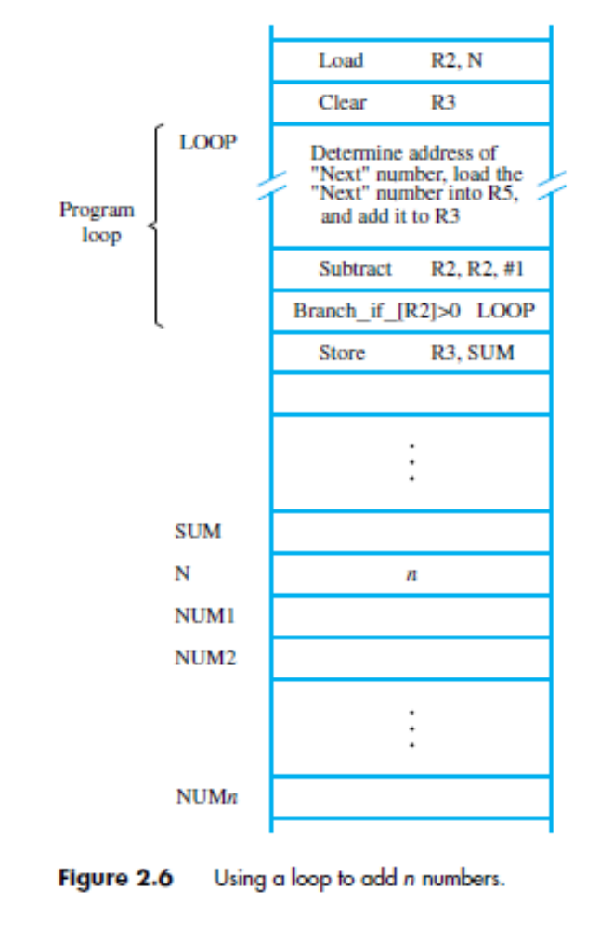
Instruction and Instruction Sequencing (11)
Branching (ctd.)
  Adding a list of n numbers
    A program loop
    Branch Instructions
      Load a new address into the PC
      Branch Target
    Conditional Branch
      Compare the contents of two
      registers
      Branch_if_[R4]>[R5] Loop
      Condition Codes

Slide 15
补充内容：E.4 Instruction Formats
  Elements of A Machine Instruction
  Instruction Address Field Format
  Opcode Format
  Example of Instruction Format

Slide 16
Instruction Formats (1)
What is Machine Instruction?
  The instructions which specify the actions that must be performed by the processor circuitry to carry out the desired tasks.
  Machine Code
  Binary
  Usually represented by assembly codes.
What is Instruction Set?
  The collection of different machine instructions that the processor can execute.
Notes:
Machine instruction：机器指令

Slide 17
Instruction Format (2)
Elements of A Machine Instruction
  Operation code
    Specify the operation to be performed (e.g.,ADD, I/O), expressed as a binary code.
  Source operand reference
    Operands required for the instruction are specified.
  Result operand reference
    Where should the result of the operation be placed?
    Source and result operands can be in one of three areas:
      Main or virtual memory or cache
      Processor register
      I/O device

Slide 18
Instruction Format (3)
Elements of A Machine Instruction (ctd.)
  Next instruction reference
    How / where is the next instruction to be found.
      In most cases, this is not explicitly stated in the instruction.
      Next instruction is the one that logically follows the current one in the program (sequential / linear progression through the program).
Instruction Representation
  Within the computer, each instruction is represented by a sequence of binary bits.

Slide 19

Instruction Formats (4)
Instruction Representation (ctd.)
  The instruction is divided into fields:
    Operation code field: Specify the operation to be performed.
    Address field
Instruction Design Criteria
  Short instructions are better than long ones.
  Sufficient room in the instruction format to express all the operations desired.
  Number of bits in the address field.

Slide 20


Instruction Formats (5)
Instruction Address Field Format
  Zero-address Instruction
  One-address Instruction
    OP [A] → A
    [AC] OP [A] → AC
      Typically, it is understood implicitly that a second operand is in the accumulator of the processor

Slide 21


Instruction Format (6)
Instruction Address Field Format (ctd.)
  Two-address Instruction
    [A1] OP [A2] → A1
    A1: Destination operand address
    A2: Source operand address
  Three-address Format
    [A1] OP [A2] → A3

Slide 22
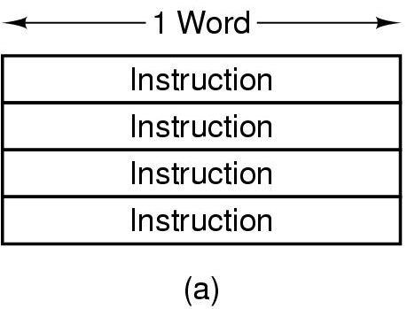
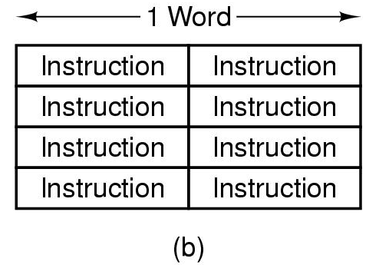
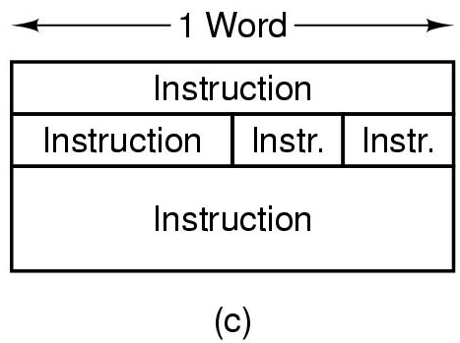
Instruction Format (7)
Instruction Length
  Fixed length: All instructions have the same length
  Variable Length: Instructions may be many different lengths

Slide 23
Instruction Format (8)
Instruction Length (ctd.)
  Methods to Reduce Instruction Length
    If the operand is to be used several times, it can be moved into a register. (If an operand is to be used only once, putting it in a register is not worth it.)
    Specify one or more operands implicitly.

Slide 24
Instruction Format (9)
Opcode Format
  Fixed-length Opcode
    Instruction length: n + k bits
    k bits opcode and n bits operand address
      Allows for 2^{k} different operations
      Allows for 2^{n} addressable memory cells
    k-1 bit opcode and n+1 bit address
      Half as many instructions but twice the addressable memory
    k+1 bit opcode and n-1 bit address
      Twice as many instructions but half the addressable memory

Slide 25
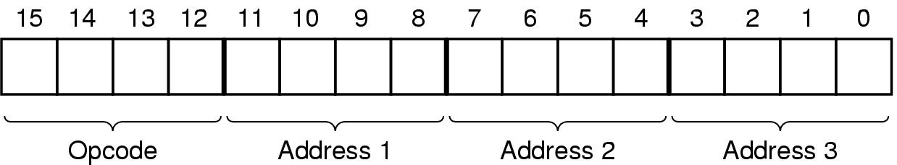
Instruction Format (10)
Opcode Format (ctd.)
  Variable-length Opcode (Expanding Opcode)
    Example: Instruction length is 16-bit, operand address is 4-bit.
      This might be reasonable on a machine that has 16 registers on which all arithmetic operations take place.
      One design would be a 4-bit opcode and three addresses in each instruction, giving 16 three-address instructions.

Slide 26
Instruction Format (11)
Opcode Format (ctd.)
  Variable-length Opcode (Expanding Opcode) (ctd.)
    Example: Instruction length is 16-bit, operand address is 4-bit. (ctd.)
      Suppose the designers need:
        15 three-address instructions
        14 two-address instructions
        31 one-address instructions
        16 zero-address instructions
      How should we design the instruction format?

Slide 27
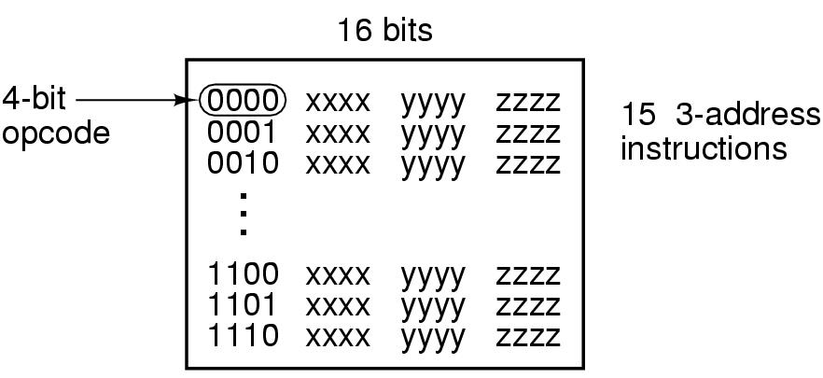

Instruction Format (12)
Opcode Format (ctd.)
  Variable-length Opcode (Expanding Opcode)
    Example: (ctd.)
      Three-address instruction
        4-bit opcode 0000 – 1110 (15 – 12 bit)

Slide 28
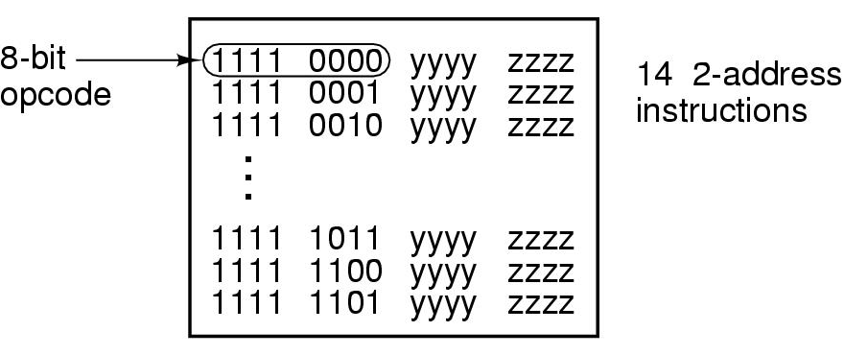
Instruction Format (13)
Opcode Format (ctd.)
  Variable-length Opcode (Expanding Opcode)
    Example: (ctd.)
      Two-address instruction
        8-bit opcode 11110000 – 11111101 (15 – 8 bit)
        1111 (15 – 12 bit) 0000 – 1101 (11 – 8 bit)

Slide 29
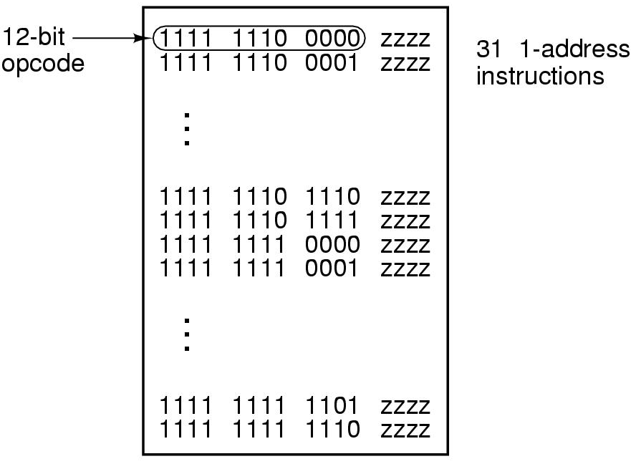
Instruction Format (14)
Opcode Format (ctd.)
  Variable-length Opcode (Expanding Opcode)
    Example: (ctd.)
      One-address instruction
        12-bit opcode 111111100000 – 111111111110 (15 – 4 bit)

Slide 30
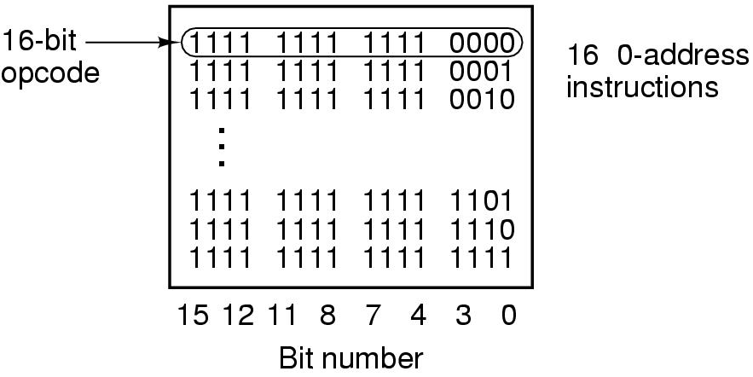
Instruction Format (15)
Opcode Format (ctd.)
  Variable-length Opcode (Expanding Opcode)
    Example: (ctd.)
      Zero-address instruction
        16-bit opcode 1111111111110000 - 1111111111111111

Slide 31
Instruction Format (16)
Opcode Format (ctd.)
  Variable-length Opcode (Expanding Opcode)
    Summary
      Expanding Opcodes demonstrates a trade-off between space for Opcode and space for other information.
      Carrying variable Opcode to an extreme, it is possible to minimize the average instruction length by encoding every instruction to minimize bits needed.
      However, this will result in instructions of various sizes that are not even aligned on byte boundaries.
      Expanding Opcodes is typically employed at the byte level like the above example.

Slide 32
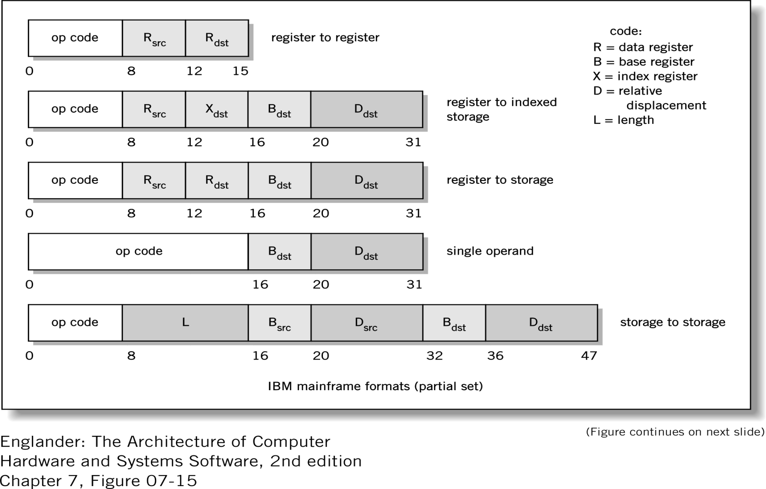
Instruction Format (17)
Example of Instruction Format

Slide 33
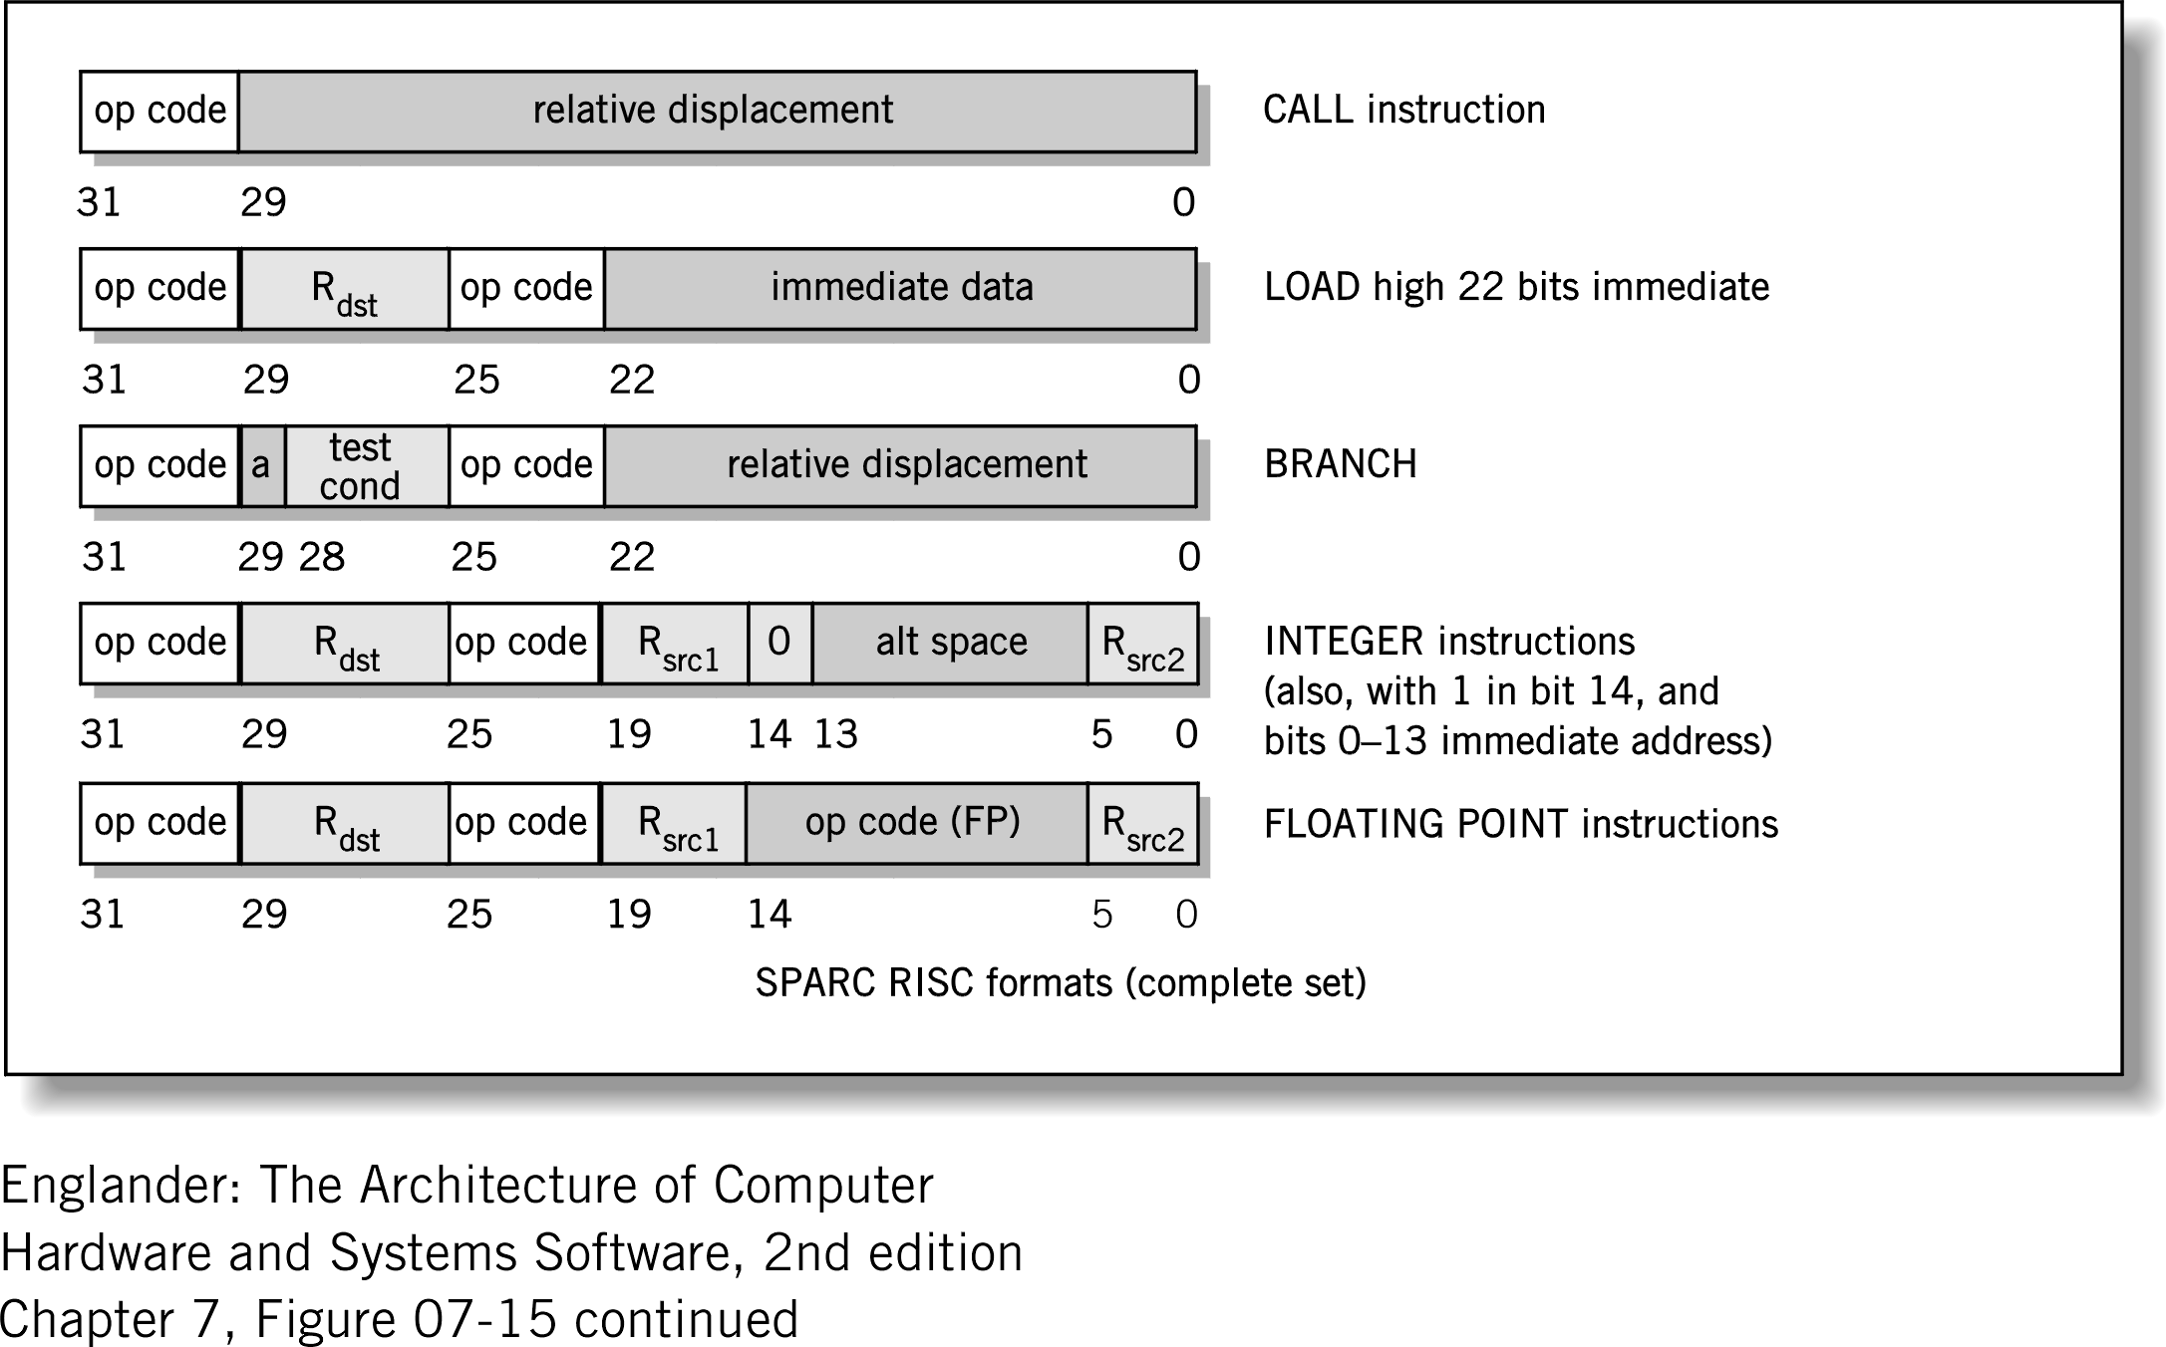
Instruction Format (18)
Example of Instruction Format (ctd.)

Slide 34
2.4 Addressing Modes
  Immediate Mode
  Absolute Mode
  Register Mode
  Register Indirect Mode
  Indirect Mode
  Index Mode (Base with Index Mode)
Notes:
Index mode: 变址方式
Base with index mode: 带变址的基址方式

Slide 35
Addressing Modes (1)
How to specify where an operand for an instruction is located?
How the bits of an address field in an instruction are interpreted?
What is Addressing Modes?
  The different ways in which the location of an operand is specified in an instruction are referred to as addressing modes.
Notes:
Once we have determined the number of addresses contained in an instruction, the manner in which each address field specifies memory location must be determined
Want the ability to reference a large range of address locations

Slide 36
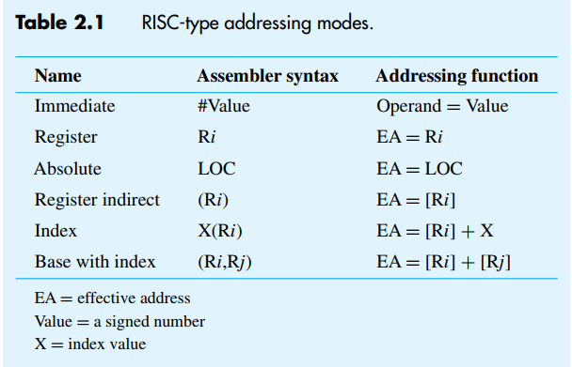
Addressing Modes (2)
Typical Addressing Modes

Slide 37
Addressing Modes (3)
Immediate Mode
  The operand is given explicitly in the instruction.
  Example: Add R4, R6, #200
  Usage
    Define and use constants
    Set initial values of variables
  Advantage
    No memory reference other than the instruction fetch is required to obtain the operand.
  Disadvantage
    Only a constant can be supplied this way.
    The size of the number is limited by the size of the address field.
OP
Operand

Slide 38
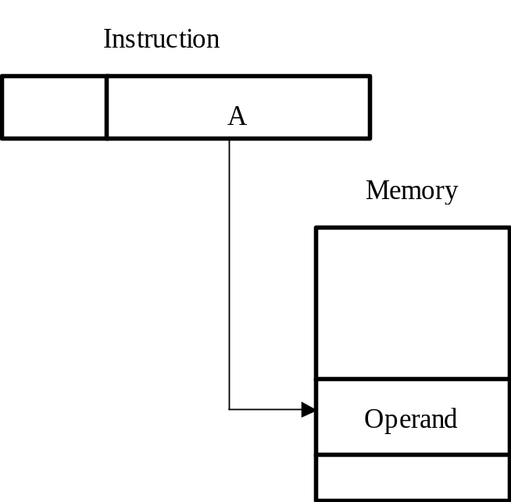
Addressing Modes (4)
Absolute Mode
  The operand is in a memory location; the address of this location is given explicitly in the instruction.
  Example: Integer NUM1, NUM2, NUM3
  Load R2 NUM1
  EA = A
  EA : actual (effective) address of the location containing the referenced operand
  A: contents of an address
  field in the instruction
  In a system without virtual memory,
  the effective address will be either
  a main memory address or a register.

Slide 39
Addressing Modes (5)
Absolute Mode (ctd.)
  In a virtual memory system, the effective address is a virtual address or a register address
  Usage
    Access global variables whose address is known at compile time.
  Advantage
    Only one memory reference and no special calculation.
  Disadvantages
    The instruction will always access exactly the same memory location.
    It provides only a limited address space.

Slide 40
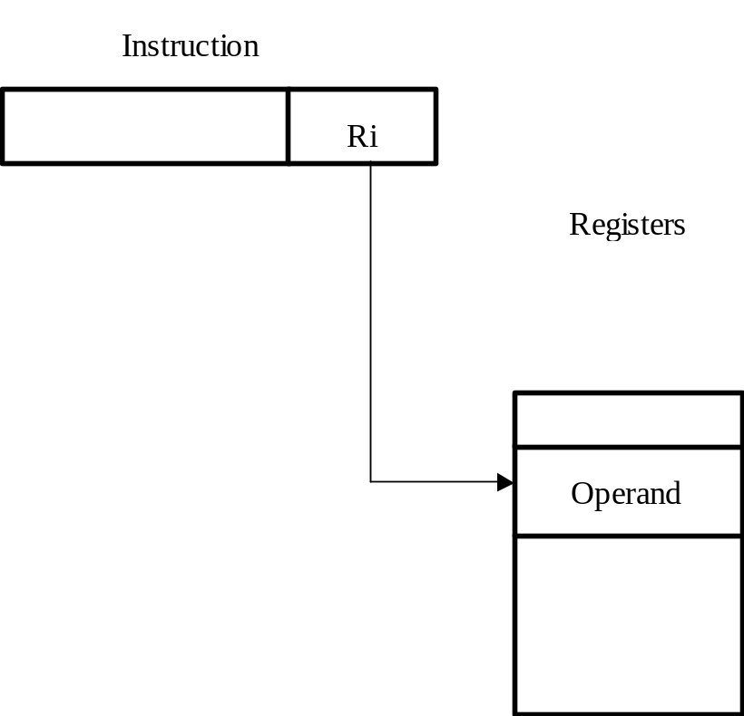
Addressing Modes (6)
Register Mode
  The operand is the contents of a processor register; the address of the register is given in the instruction.
  EA = Ri
  Ri : contents of an address
  field in the instruction that
  refers to a register.
  Example Add R4, R2, R3
  Usage
    Access variables which are
    accessed most often

Slide 41
Addressing Modes (7)
Register Mode (ctd.)
  Advantages
    Only a small address field is needed in an instruction.
    No memory references are required.
  Disadvantage
    The address space is very limited.

Slide 42
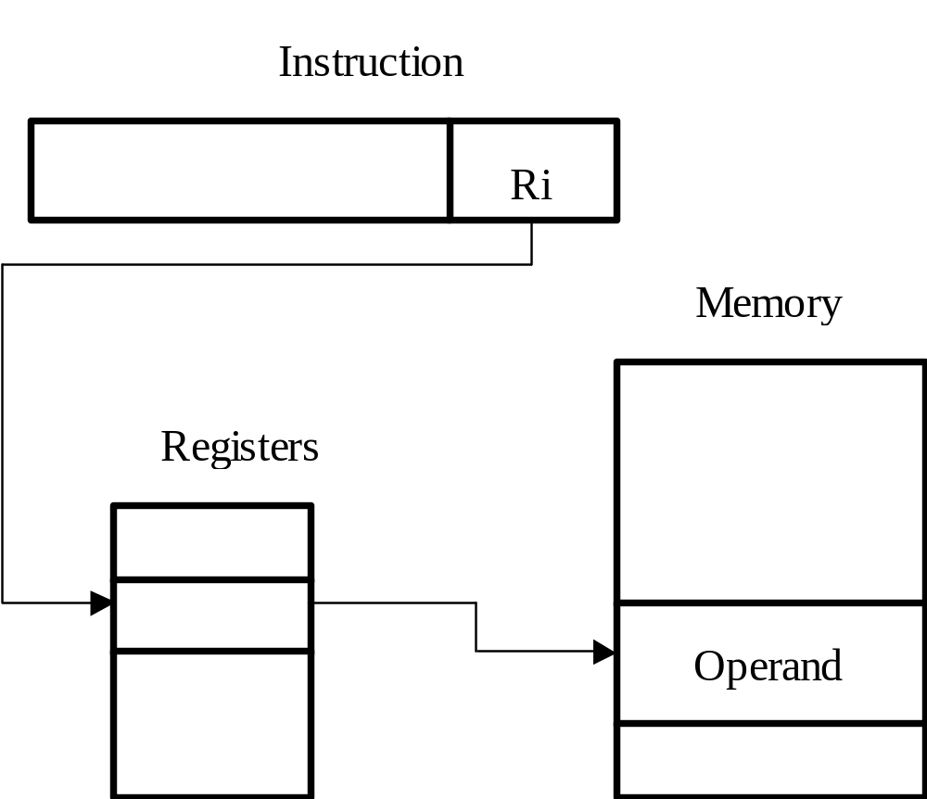
Addressing Modes (8)
Register Indirect Mode
  The effective address of the operand is the contents of a register that is specified in the instruction.
  EA = [Ri]

Slide 43
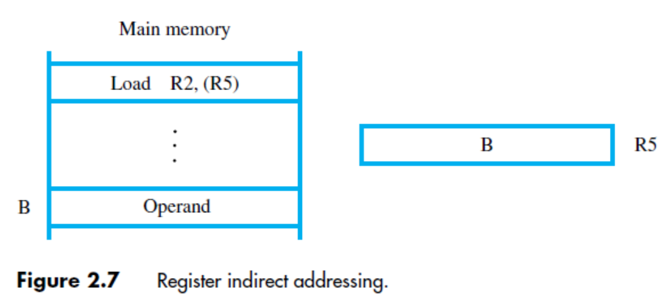
Addressing Modes (9)
Register Indirect Mode (ctd.)
  Example Load R2, (R5)

Slide 44
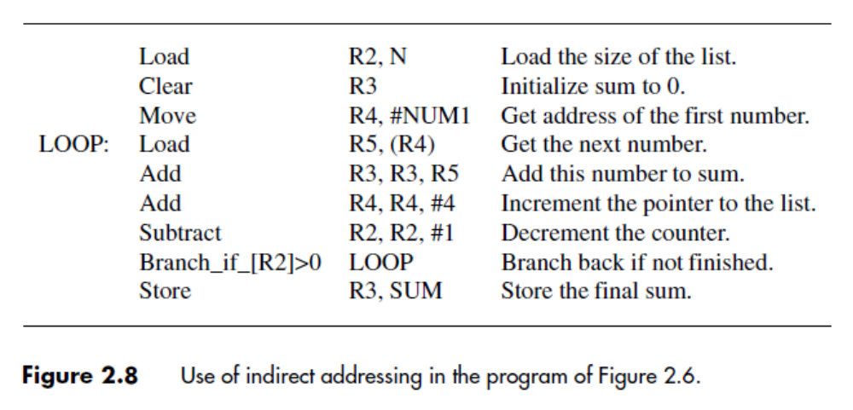
Addressing Modes (10)
Register Indirect Mode (ctd.)
  Example: Using indirect addressing to access a list of n numbers
Notes:
4.23 Class 5,6

Slide 45
Addressing Modes (11)
Register Indirect Mode (ctd.)
  Advantages
    It can reference memory without paying the price of having a full memory address in the instruction.
    Reduce the memory access times.
Notes:
4.23 Class 5,6

Slide 46
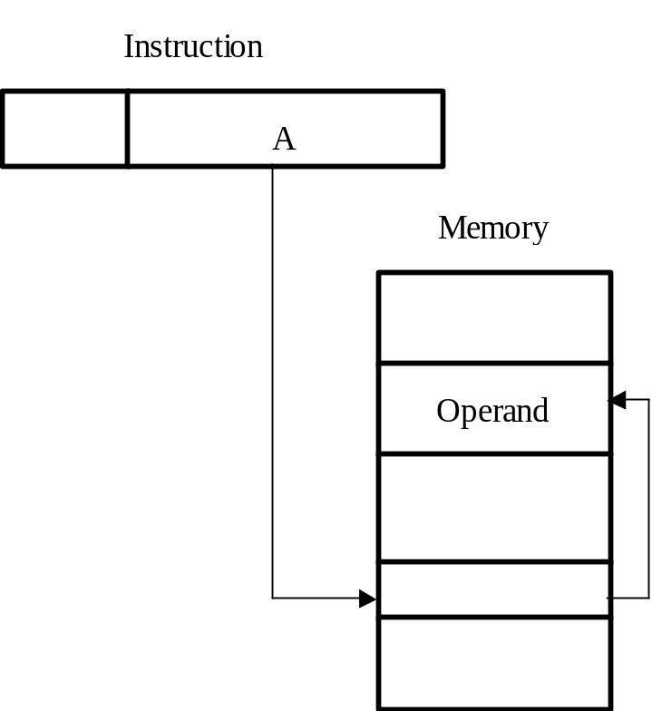
Addressing Modes (12)
Indirect Mode
  Indirect addressing through a memory location is also possible, but it is found only in CISC-style processors.
  The effective address of the operand is the contents of a memory location whose address appears in the instruction.
  EA = [A]
  Example: Add (A), R0
Add (A),R0
A
B
B
Operand

Slide 47
Addressing Modes (13)
Indirect Mode (ctd.)
  Advantage
    The address space is very large.
      Memory word length N->2^{N} address space
  Disadvantage
    Instruction execution requires two memory references to fetch the operand : one to get its address and a second to get its value.
  Multilevel Indirect Addressing
    EA = […[A]…]
    One bit of a full-word address is an indirect flag (I).
      If the I bit is 0, then the word contains the EA.
      If the I bit is 1, then another level of indirection is invoked.

Slide 48
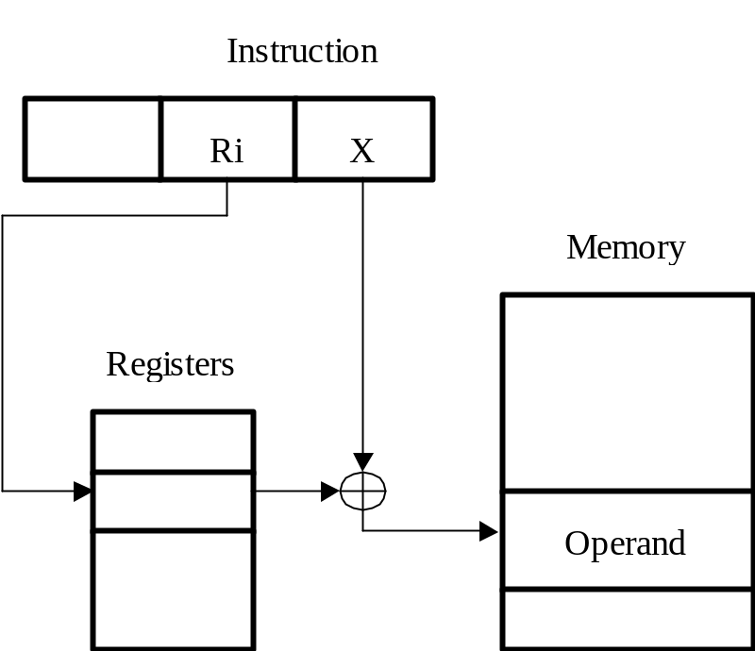
Addressing Modes (14)
Index Mode
  X(Ri)
  The effective address of the operand is generated by adding a constant value to the contents of a register (index register).
  EA = X + [Ri]
  X (offset) : the constant value contained in the instruction
  The contents of the index register are not changed in the process of generating the effective address.

Slide 49
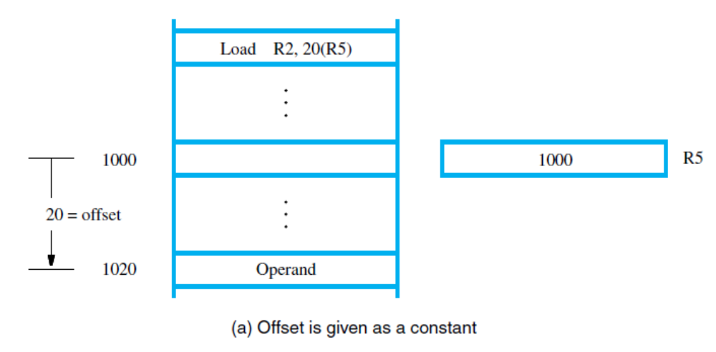
Addressing Modes (15)
Index Mode (ctd.)
  Two Ways of Using the Index Mode
    Offset is given as a constant

Slide 50
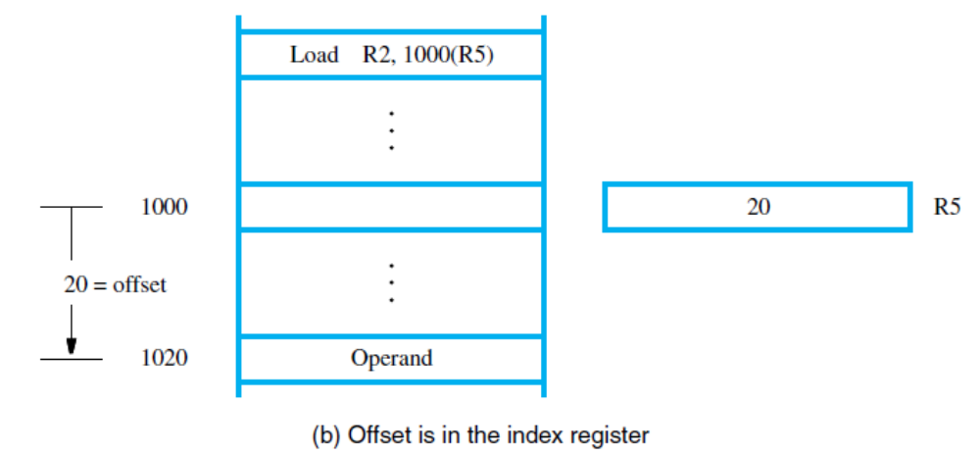
Addressing Modes (16)
Index Mode (ctd.)
  Two Ways of Using the Index Mode (ctd.)
    Offset is in the index register. This form requires an offset field in the instruction large enough to hold an address.

Slide 51
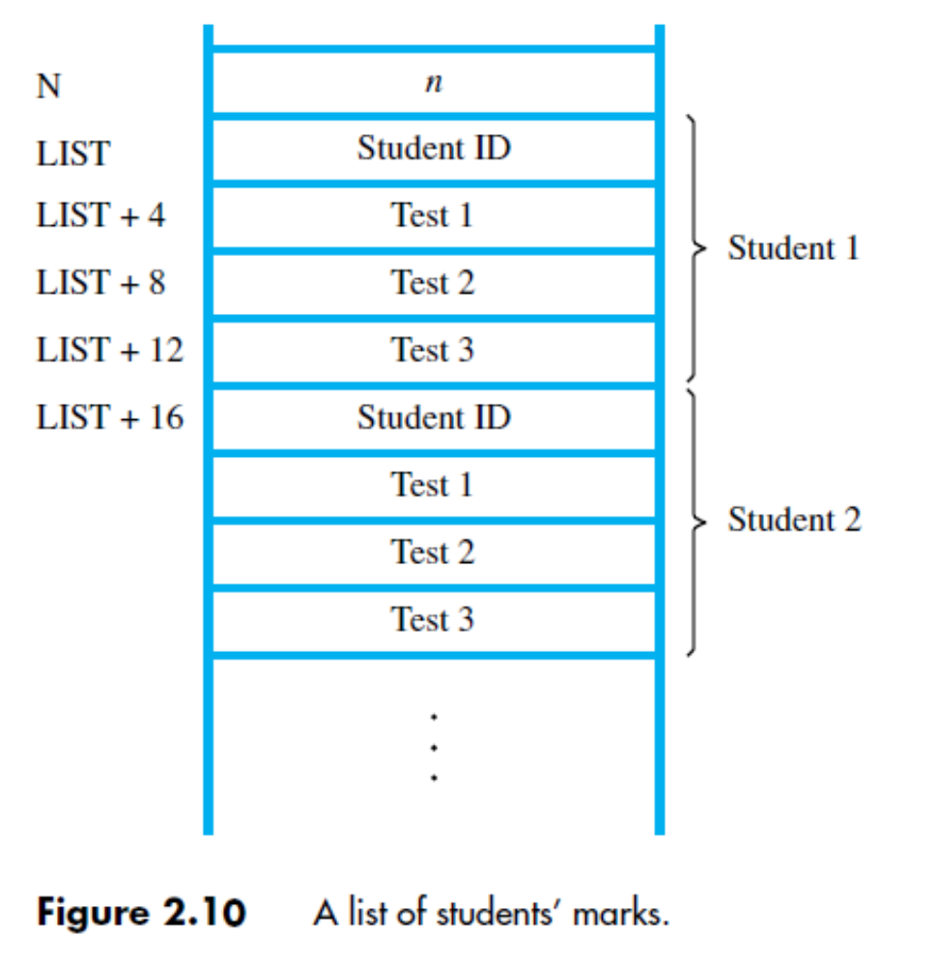
Addressing Modes (17)
Index Mode (ctd.)
  Usage
    Facilitate access to an operand whose location is defined relative to a reference point within the data structure in which the operand appears.
  Usage Example
    N rows and four columns array
The memory is byte addressable and the word length is 32 bits.
Notes:
讲到这里—2018.10.30

Slide 52
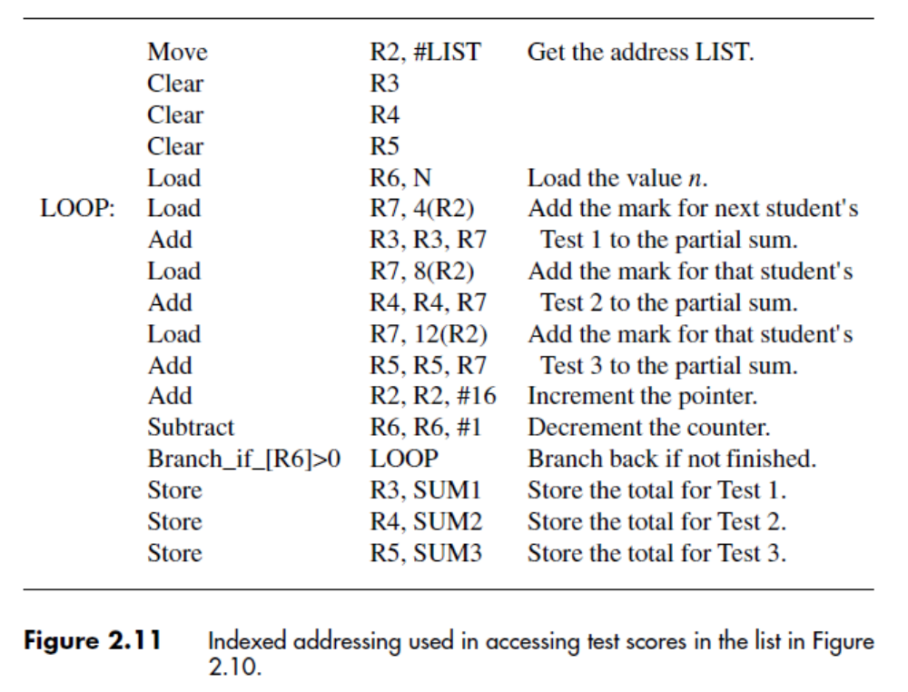
Addressing Modes (18)
Index Mode (ctd.)
  Usage Example (ctd.)

Slide 53
Addressing Modes (19)
Index Mode (ctd.)
  Variations of index addressing
    Base with index
      (Ri, Rj)
      A second register ( base register) is used to contain the offset X.
      EA = [Ri] + [Rj]
    Base with index and offset
      X(Ri, Rj)
      Use index register, base register and a constant.
      EA = [Ri] + [Rj] + X

Slide 54
Stacks (1)
A stack is a list of data elements, usually words, with the accessing restriction that elements can be added or removed at one end of the list only.
The structure is sometimes referred to as a pushdown stack or last-in–first-out (LIFO) stack.
Push
  Place a new item on the stack
Pop
  Remove the top item from the stack
In modern computers, a stack is implemented by using a portion of the main memory.
Programmer can create a stack in the memory
There is often a special processor stack as well

Slide 55
Stacks (2)
Processor Stack
  Processor has stack pointer (SP) register
  that points to top of the processor stack
  Assume a byte-addressable memory with a 32-bit word length
  Push operation involves two instructions:
  Subtract SP, SP, #4
  Store Rj, (SP)
  Pop operation also involves two instructions:
  Load Rj, (SP)
  Add SP, SP, #4

Slide 56
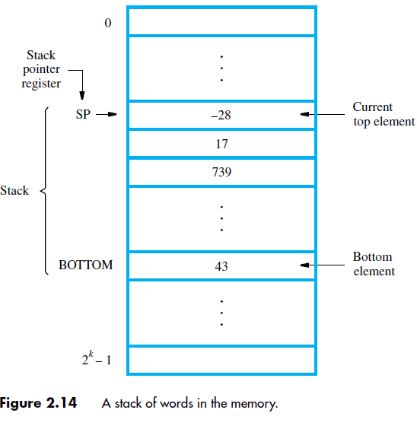
Stacks (3)
Processor
Stack (ctd.)

Slide 57
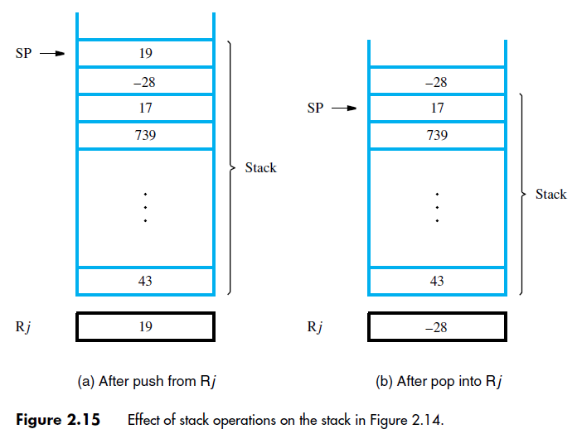
Stacks (4)
Processor Stack (ctd.)

Slide 58
Subroutines (1)
In a given program, a particular task may be
executed many times using different data
  Examples: mathematical function, list sorting
Implement task in one block of instructions
  This is called a subroutine
Rather than reproduce entire subroutine block in each part of program, use a subroutine call
  Special type of branch with Call instruction
Notes:
Subroutine: 子程序
A block of instructions: 指令块
Call: 调用

Slide 59
Subroutines (2)
Branching to same block of instructions
saves space in memory, but must branch back
  The subroutine must return to calling program after executing last instruction in subroutine
  This branch is done with a Return instruction
Subroutine Linkage
  Subroutine can be called from different places
  How can return be done to correct place?
    This is the issue of subroutine linkage
Notes:
Subroutine linkage: 子程序链接

Slide 60
Subroutines (3)
Subroutine Linkage (ctd.)
  During execution of Call instruction, PC updated to point to instruction after Call
  Save this address for Return instruction to use
  Simplest method: place address in link register
  Call instruction performs two operations: store updated PC contents in link register, then branch to target (subroutine) address
  Return just branches to address in link register
Notes:
Link register: 链接寄存器

Slide 61
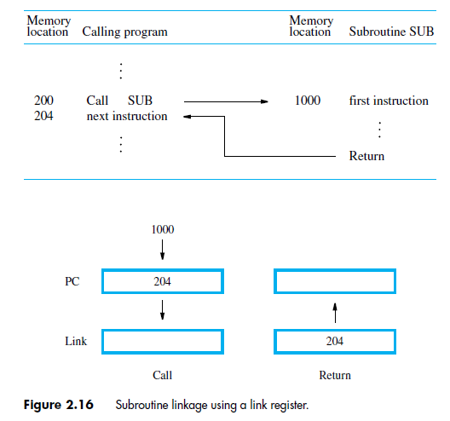
Subroutines (4)
Subroutine Linkage (ctd.)

Slide 62
Subroutines (5)
Subroutine Nesting & The Processor Stack
  We can permit one subroutine to call another, which results in subroutine nesting.
  Link register contents after first subroutine call are overwritten after second subroutine call.
  First subroutine should save link register on the processor stack before second call.
  After return from second subroutine, first subroutine restores link register.
  Subroutine nesting can be carried out to any depth.
  Return addresses are generated and used in a last-in–first-out order. This suggests that the return addresses associated with subroutine calls should be pushed onto the processor stack.
Notes:
Subroutines nesting: 子程序嵌套
Processor stack: 处理器堆栈

Slide 63
2.8 Additional Instructions
  Logic Instructions
  Shift and Rotate Instructions
  Multiplication and Division

Slide 64
Additional Instructions (1)
Logic Instructions
  AND, OR, and NOT operations on single bits
  are basic building blocks of digital circuits.
  Similar operations in software on multiple bits.
  Using RISC-style instructions, all operands are
  in registers or specified as immediate values:
  Or R4, R2, R3
  And R5, R6, #0xFF
    8-bit immediate is zero-extended to 32 bits

Slide 65
Additional Instructions (2)
Logic Instructions (ctd.)
  Suppose that four ASCII characters are contained in the 32-bit register R2. In some task, we wish to determine if the rightmost character is Z. The ASCII code for Z is 01011010, which is expressed in hexadecimal notation as 5A.
    And R2, R2, #0xFF
    Move R3, #0x5A
    Branch_if_[R2]=[R3] FOUNDZ
Notes:
如果相匹配，就产生一个到FOUNDZ的跳转。

Slide 66
Additional Instructions (3)
Shift and Rotate Instructions
  Shifting binary value left/right = mult/div by 2
  Logical Shifts
    For general operands, we use a logical shift.
    Logic Shifting Left (LShiftL)
    LShiftL Ri, Rj, count
    Shift the contents of register Rj left by a number of bit positions given by the count operand, and places the result in register Ri, without changing the contents of Rj.
    Logic Shifting Right (LShiftR)

Slide 67
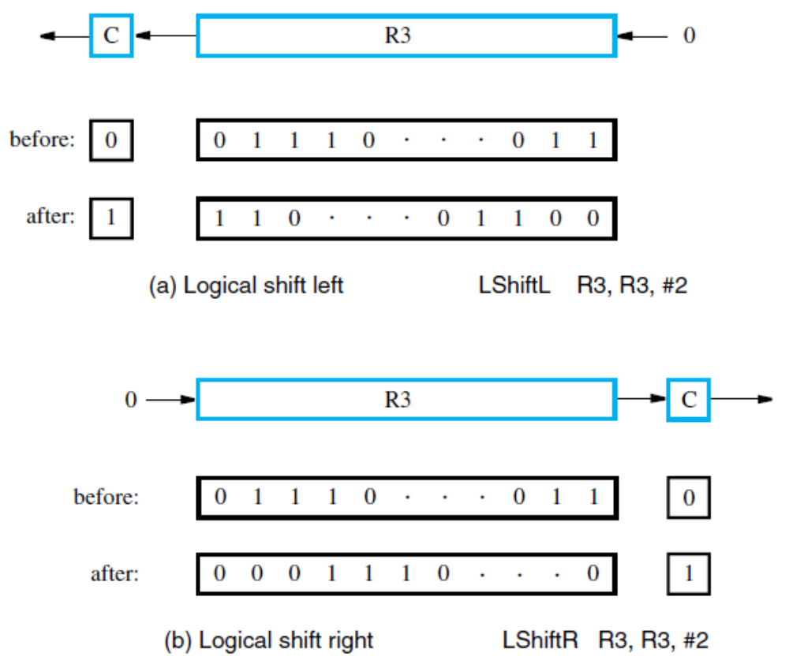
Additional Instructions (4)
Shift and Rotate Instructions (ctd.)
  Logical Shifts (ctd.)

Slide 68
Additional Instructions (5)
Shift and Rotate Instructions (ctd.)
  Digit-Packing Example
    Illustrate shift, logic, byte-access instructions
    Memory has two binary-coded decimal digits
    Pointer set to 1st byte for index-mode access to load 1st digit, which is shifted to upper bits
    Upper bits of 2nd digit are cleared by ANDing
    ORing combines 2nd digit with shifted 1st digit for result of two packed digits in a single byte
    32-bit registers, but only 8 lowest bits relevant
Notes:
Digit-packing: 数字打包

Slide 69
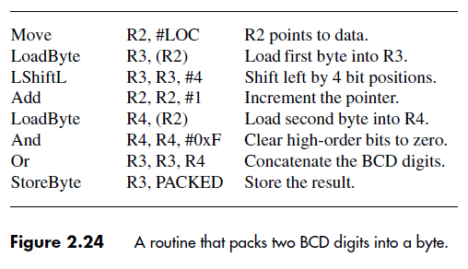
Additional Instructions (6)
Shift and Rotate Instructions (ctd.)
  Digit-Packing Example (ctd.)
Notes:
BCD: binary coded decimal 用二进制表示的十进制数

Slide 70
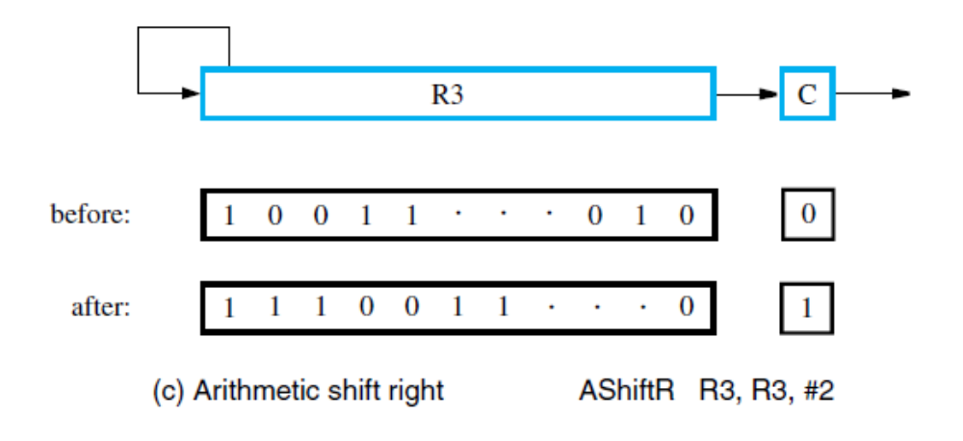
Additional Instructions (7)
Shift and Rotate Instructions (ctd.)
  Arithmetic Shifts
    In an arithmetic shift, the bit pattern being shifted is interpreted as a signed number.
    On a right shift the sign bit must be repeated as the fill-in bit for the vacated position as a requirement of the 2’s-complement representation for numbers.

Slide 71
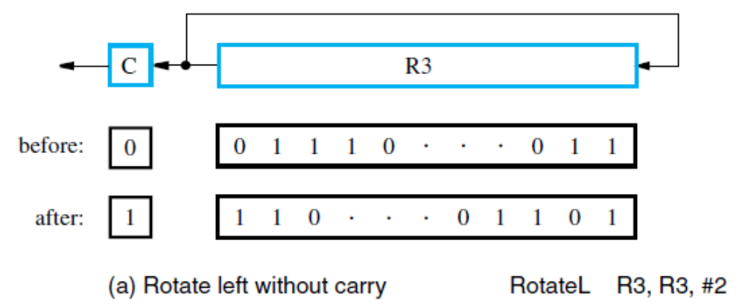
Additional Instructions (8)
Shift and Rotate Instructions (ctd.)
  Rotate Operations
    Rotate left without carry

Slide 72
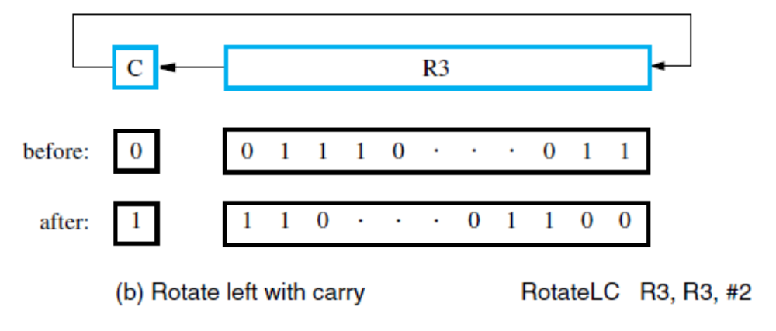
Additional Instructions (9)
Shift and Rotate Instructions (ctd.)
  Rotate Operations (ctd.)
    Rotate left with carry

Slide 73
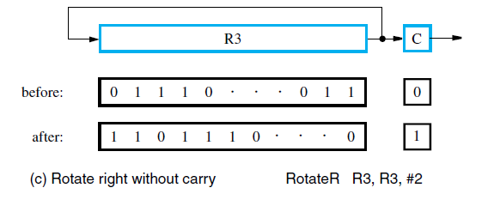
Additional Instructions (10)
Shift and Rotate Instructions (ctd.)
  Rotate Operations (ctd.)
    Rotate right without carry

Slide 74
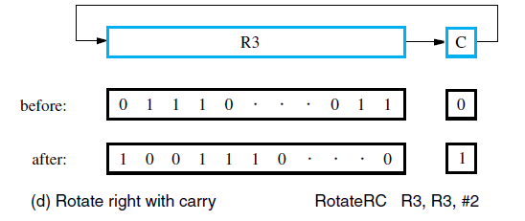
Additional Instructions (11)
Shift and Rotate Instructions (ctd.)
  Rotate Operations (ctd.)
    Rotate right with carry

Slide 75
Additional Instructions (12)
Multiplication and Division
  Signed integer multiplication of n-bit numbers produces a product with as many as 2n bits
  Processor truncates product to fit in a register:
  Multiply Rk, Ri, Rj (Rk ← [Ri] × [Rj])
  For general case, 2 registers (Rk and R(k+1)may hold result
  Integer division produces quotient as result:
  Divide Rk, Ri, Rj (Rk ← [Ri] / [Rj])
  Remainder is discarded or placed in a register R(k+1)

Slide 76
2.10 CISC Instruction Sets
  Additional Addressing Modes
  Condition Codes

Slide 77
CISC Instruction Sets (1)
CISC instruction sets are not constrained to the load/store architecture, in which arithmetic and logic operations can be performed only on operands that are in processor registers.
CISC instructions do not necessarily have to fit into a single word. Some instructions may occupy a single word, but others may span multiple words.
Most arithmetic and logic instructions use the two-address format.
  Operation destination, source
  Example: Add B, A
    Performs the operation B ← [A] + [B] on memory operands.

Slide 78
CISC Instruction Sets (2)
The Move instruction includes the functionality of the Load and Store instructions
  Move destination, source
  Example C = A + B
    Move C, B
    Add C, A
  In some CISC processors one operand may be in the memory but the other must be in a register.
    Move Ri, A
    Add Ri, B
    Move C, Ri

Slide 79
CISC Instruction Sets (3)
Autoincrement and Autodecrement Mode
  Autoincrement Mode
    The effective address of the operand is the contents of a register specified in the instruction. After accessing the operand, the contents of this register are automatically incremented to point to the next item in a list.
    (Ri)+
    EA = [Ri] Increment Ri
    Useful for adjusting pointers in loop body:
    Add SUM, (Ri)+
    MoveByte (Rj)+, Rk
      Increment by 4 for words, and by 1 for bytes
Notes:
自动增量自动减量方式

Slide 80
CISC Instruction Sets (4)
Autoincrement and Autodecrement Mode (ctd.)
  Autodecrement Mode
    The contents of a register specified in the instruction are first automatically decremented and are then used as the effective address of the operand.
    −(Ri)
    Use autoinc. & autodec. for stack operations:
    Move −(SP), NEWITEM (push)
    Move ITEM, (SP)+ (pop)

Slide 81
CISC Instruction Sets (5)
Relative Mode
  The effective address is determined by the Index mode using the program counter in place of the general-purpose register Ri.
  EA = [PC] + X, X is a signed number
  Usage
    Access data operand
    Specify the target address in branch instructions.
      Example Branch > 0 Loop
        The branch target location can be computed by specifying it as an offset from the current value of the program counter.
Notes:
相对方式

Slide 82
CISC Instruction Sets (6)
Condition Codes
  Processor can maintain information on results to affect subsequent conditional branches
  Results from arithmetic/comparison & Move
  Condition code flags in a status register:
  N (negative) 1 if result negative, else 0
  Z (zero) 1 if result zero, else 0
  V (overflow) 1 if overflow occurs, else 0
  C (carry) 1 if carry-out occurs, else 0
Notes:
Condition codes: 条件码
Condition code flags: 条件码标记
Status register: 状态寄存器

Slide 83
CISC Instruction Sets (7)
Branches Using Condition Codes
  CISC branches check condition code flags
  For example, decrementing a register causes N and Z flags to be cleared if result is not zero
  A branch to check logic condition N + Z = 0:
  Branch>0 LOOP
  Other branches test conditions for <, =, ≠, ≤, ≥
  Also Branch_if_overflow and Branch_if_carry
  Consider CISC-style list-summing program (next page)

Slide 84
CISC Instruction Sets (8)
Branches Using Condition Codes (ctd.)

Slide 85
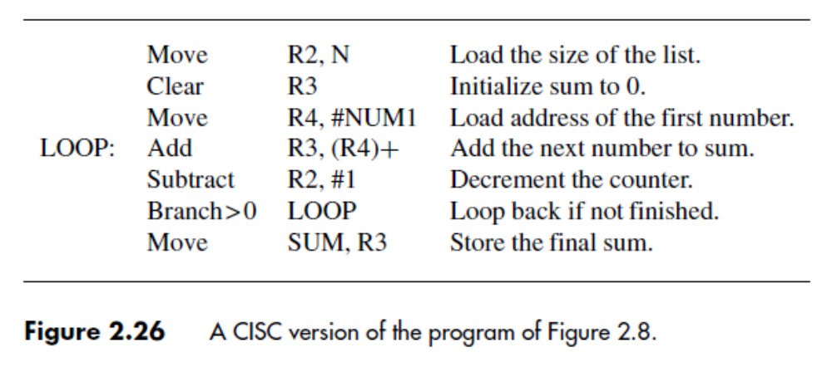
CISC Instruction Sets (9)
Branches Using Condition Codes (ctd.)

Slide 86
RISC and CISC Styles (1)
RISC characteristics include:
  Simple addressing modes
  All instructions fitting in a single word
  Fewer total instructions
  Arithmetic/logic operations on registers
  Load/store architecture for data transfers
  More instructions executed per program
Simpler instructions make it easier to
design faster hardware (e.g., use of pipelining)

Slide 87
RISC and CISC Styles (2)
CISC characteristics include:
  More complex addressing modes
  Instructions spanning more than one word
  More instructions for complex tasks
  Arithmetic/logic operations on memory
  Memory-to-memory data transfers
  Fewer instructions executed per program
Complexity makes it somewhat more difficult to design fast hardware, but still possible

Slide 88
RISC and CISC Styles (3)
Before the 1970s, all computers were of CISC type.
  Move the complexity from the software level to the hardware level.
RISC-style designs emerged as an attempt to achieve very high performance by making the hardware very simple.
Today’s processors often exhibit what may seem to be a compromise between these approaches.

Slide 89
Summary (1)
Instruction Formats
  Instruction Representation
  Common Instruction Address Field Formats
    Zero-address Instruction
    One-address instruction
    Two-address instruction
    Three-address instruction
  Instruction length
  Opcode format (expanding opcode)

Slide 90
Summary (2)
Addressing Modes
  Definition: The different ways in which the location of an operand is specified in an instruction are referred to as addressing modes.
  Typical Addressing Modes
    Immediate mode
    Direct mode (Absolute mode)
    Register mode
    Indirect mode
    Register indirect mode
    Index mode
    Relative mode
    Autoincrement mode
    Autodecrement mode

Slide 91
Summary (3)
RISC Characteristics
CISC Characteristics

